Slide 1
Theme Style Guide
Accent Slot | Hext Color | Usage
Accent 1 | #XXXXXX | Slide Titles, major headings
Accent 2 | #XXXXXX | Secondary Headers, comparison titles
Accent 3 | #XXXXXX | Highlight callouts, icon files
Accent 4 | #XXXXXX | Links, interactive elements
Accent 5 | #XXXXXX | Alerts, warnings, caution text
Accent 6 | #XXXXXX | Captions, footers, diver lines
Corina
Corina
Corina
Corina
Corina
Corina

Slide 2
Style Guide: Color Palette (Base Colors)
Role | Hex Color | Usage
Text/Background – Dark 1 | #333333 | Primary text
Text/Background – Light 1 | #FFFFFF | Slide background
Text/Background – Dark 2 | #003366 | High-contrast text (e.g., captions, data overlays)
Text/Background – Light 2 | #F4F6F7 | Soft fill areas, minimal containers
Hyperlink | #3399FF | Linked text in body placements
Followed Hyperlink | #DD3377 | Previously click links

Slide 3
Style Guide: Color Palette (Accent Colors)
Accent Slot | Hex Color | Usage
Accent 1 | #003366 | Main slide titles, major headers
Accent 2 | #008080 | Primary box fills, minor headings, comparison titles
Accent 3 | #DD3377 | Secondary content box fills, icon fills, highlight overlays
Accent 4 | #FF6600 | Links, callouts, interaction indicators
Accent 5 | #3399FF | Alerts, caution text, emphasis on risks
Accent 6 | #666666 | Footer text, captions, divider lines, body text for inactive elements

Slide 4
Theme Style Guide: Typography
Slide Title | Font Family | Style | Size (pts) | Line Spacing
Slide Title | Kamerik205 8 | Regular | 44 | —
Section Header | Inter | Semibold or Bold | 36 / 20-22 | —
Body Level 1 | Inter | Regular | 28 | Multiple 1.15
Body Level 2 | Inter | Regular | 24 | Multiple 1.15
Body Level 3 | Inter | Regular | 20 | Multiple 1.15
Body Level 4 | Inter | Regular | 18 | Multiple 0.90
Body Level 5 | Inter | Regular | 18 | Multiple 0.90
Caption/Label Text | Inter | Medium | 16 | —
Footer Text | Inter | Italic | 14 | —

Slide 5
Style Guide: Layouts
Layout Name | Use Case | Key Features
Title Slide | Opening slide with workshop or session title | Completely blank; expects a title slide image to be used
Title and Content | General-purpose slides with bullets or visuals | Default layout with full-width title and body placeholder
Section Header | Slide breaks for new topics or modules | High-emphasis title, optional supporting visual or icon
Two Content | Binary workflows or parallel breakdowns | Equal width placeholders
Comparison | A vs B pattern contrasts | Titles above each content box, divider line
Title Only | Modular storytelling grid (1-4 content boxes per row) | Full-width title, guide-based grid (12 columns x 9 rows) box fills in Accent 3/2
Blank | Custom slides, visual experiments, isolated visuals | No placeholders, use guides or freestyle design
Content with Caption | Small narrative zone + major visual zone | Left text zone, right content zone
Picture with Caption | Image-driven slides with descriptive labeling | Full-width image placeholder

Slide 6
Style Guide: Content Box Styles
Primary
Primary
Primary
Secondary
Secondary
Secondary
Primary
Primary
Secondary
Secondary
Primary
Primary
Secondary
Primary
Secondary
Primary

Slide 7
Style Guide: Content Box Fill Styling
Box Type | Fill | Overlay | Text Color | Notes
Primary | Accent 3 @ 20% | None | Dark 1 | For active context boxes
Secondary | Accent 2 @ 20% | None | Dark 1 | Supporting or alternate boxes
Inactive | Accent 3 or 2 | Shadow overlay @ 20% opacity | Accent 6 | Creates depth, dims focus interntionally

Slide 8
Resilience & Reliability
Notes:
Welcome to the Resilience and Reliability module. In this section, we will focus on patterns that ensure your messaging systems are robust, fault-tolerant, and capable of maintaining high availability even under challenging conditions. Building resilient and reliable messaging solutions is crucial for creating dependable and scalable systems that can withstand failures and continue to operate smoothly.
By the end of this module, you'll have the tools and knowledge to design messaging solutions that can handle failures gracefully and ensure consistent and reliable message processing. Let's dive into the techniques that will make your messaging systems resilient and dependable!

Slide 9
Resilience & Reliablity
Pattern 1: Circuit Breaker

Slide 10
What is the Circuit Breaker Pattern
Detects and handles failures gracefully
Improve system resilience and stability
Notes:
Definition
The Circuit Breaker pattern is a design pattern used to detect and handle failures gracefully. It acts as a protective barrier, stopping the flow of requests to a failing service to prevent cascading failures across the system. When the failure rate exceeds a certain threshold, the circuit breaker “trips” and redirects requests to a fallback mechanism.
Purpose
The purpose of the Circuit Breaker pattern is to improve system resilience and stability by preventing failed operations from overwhelming the system and allowing for graceful recovery.

Slide 11
Key Components & Flow
Circuit Breaker State
Failure Threshold
Fallback Mechanism
Recovery Logic
Notes:
Circuit Breaker State: The state of the circuit breaker can be “Closed” (normal operation), “Open” (tripped, blocking requests), or “Half-Open”) (testing to see if the issue is resolved).
Failure Threshold: The predefined threshold for failures that triggers the circuit breaker to trip.
Fallback Mechanism: Alternative logic or service that is invoked when the circuit breaker is in the “Open” state.
Recovery Logic: Logic to periodically test the failing service and transition the circuit breaker back to the “Closed” state if the issues is resolved.

Slide 12

Key Components & Flow
Circuit Breaker State
Failure Threshold
Open
Closed
Fallback Mechanism
Queue/Topic
Consumer
Circuit Breaker
Recovery Logic
Notes:
Circuit Breaker State: The state of the circuit breaker can be “Closed” (normal operation), “Open” (tripped, blocking requests), or “Half-Open”) (testing to see if the issue is resolved).
Failure Threshold: The predefined threshold for failures that triggers the circuit breaker to trip.
Fallback Mechanism: Alternative logic or service that is invoked when the circuit breaker is in the “Open” state.
Recovery Logic: Logic to periodically test the failing service and transition the circuit breaker back to the “Closed” state if the issues is resolved.

Slide 13
Benefits
Resiliency
Faster Failure Detection
Resource Optimization
Notes:
Improved Resilience: Protects the system from cascading failures, allowing for graceful degradation and recovery.
Faster Failure Detection: Quickly identifies and responds to failures, preventing prolonged periods of unavailability.
Resource Optimization: Reduces the load on failing services, allowing them to recover without being overwhelmed by continuous requests.

Slide 14
Drawbacks
Complexity
Latency
False Positives
Notes:
Increased Complexity: Adds complexity to the system design, requiring careful configuration and management of the circuit breaker.
Potential Latency: Introducing a circuit breaker may add latency to the request, especially if fallback mechanisms are involved.
False Positives: Incorrect configuration of thresholds and timings may lead to unnecessary tripping of the circuit breaker, affecting system performance.

Slide 15
Use Cases
External Service Failures
Temporary Overload
Error Threshold Management
Notes:
External Service Failures
Protects the system from cascading failures, allowing for graceful degradation and recovery.
Temporary Overload
During period of high load, the circuit breaker can prevent the system from becoming overwhelmed by temporarily stopping requests to certain components.
Error Threshold Management
Managing scenarios where the error rate for a particular eservice exceeds a predefined threshold, indicating a problem that needs to be address.

Slide 16
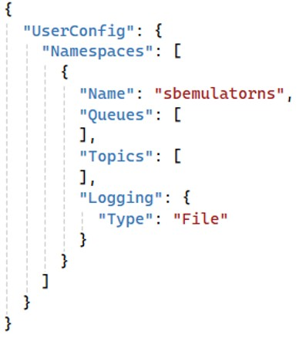
Documentation
Create the Namespace

Slide 17
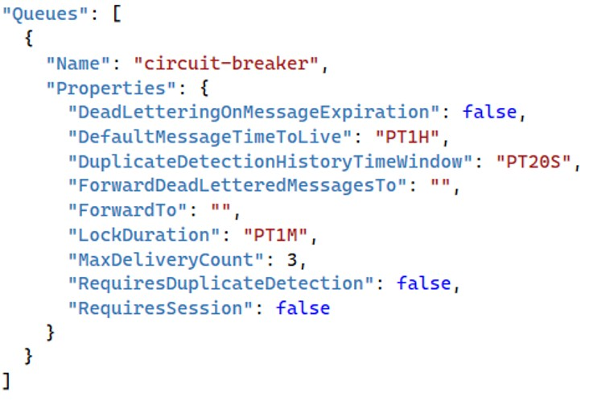
Documentation
Create the Namespace
Create the Queue

Slide 18
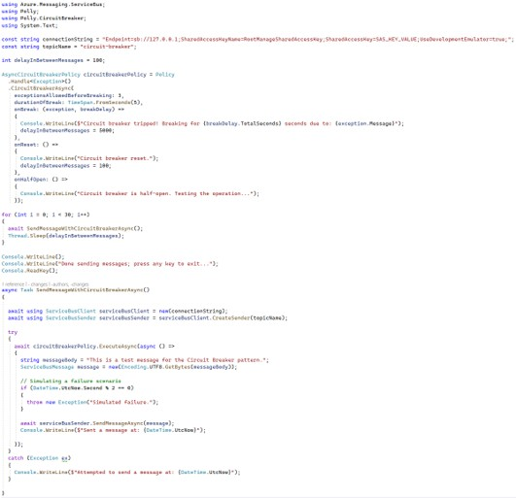
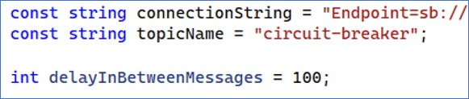
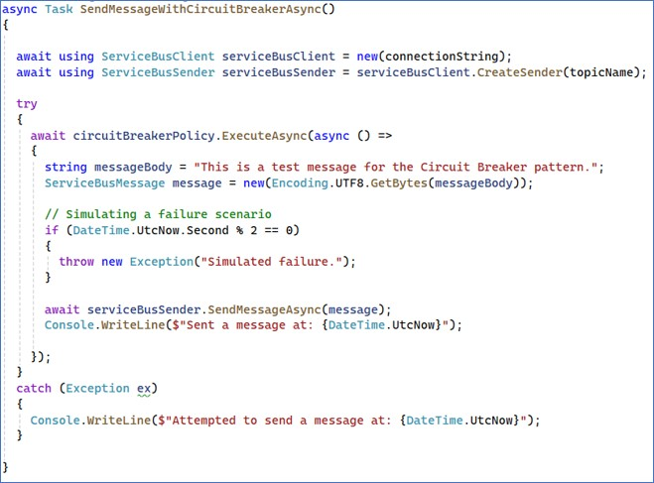
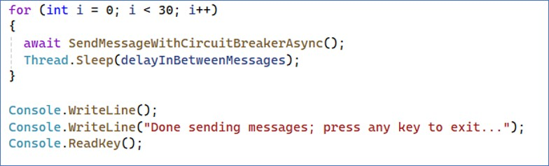
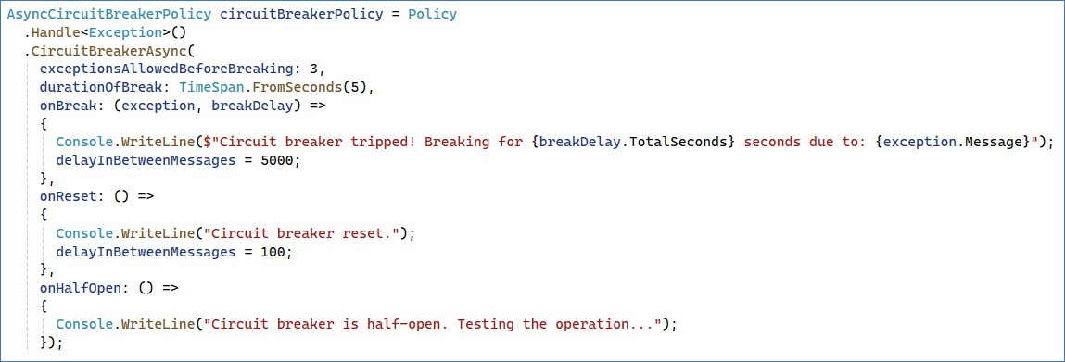
Documentation
Create the Namespace
Create the Queue
Create the Producer

Slide 19

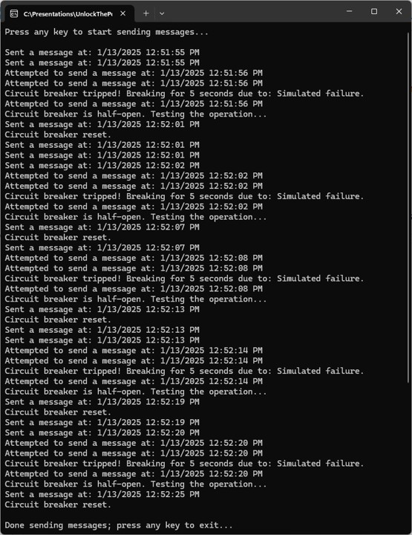
Documentation
Create the Namespace
Create the Queue
Create the Producer
Run the Demo

Slide 20
Key Points to Remember
Configure Thresholds
Implement Fallbacks
Monitor and Adjust
Test Recovery
Notes:
Configure Thresholds: Set appropriate failure thresholds and timings to ensure the circuit breaker trips only when necessary.
Implement Fallbacks: Provide fallback mechanisms to handle requests when the circuit breaker is tripped, ensuring continued operation.
Monitor and Adjust: Continuously monitor the circuit breaker state and adjust configurations as needed to optimize performance and resilience.
Test Recovery: Implement recovery logic to periodically test the failing service and transition the circuit breaker to the “Half-Open” state to determine fi it can be closed.

Slide 21
Resilience & Reliabiity
Pattern 2: Saga Pattern

Slide 22
What is the Saga Pattern
Breaks the transaction into a series of smaller, independent steps
Managing long-running transactions
Notes:
Definition
The Saga pattern is a design pattern used to manage and coordinate long-running transactions in a distributed system. Instead of using a single monolithic transaction, the Saga pattern breaks the transaction into a series of smaller, independent steps, each with its own compensating action to undo the step in case of failure
Purpose
The purpose of the Saga pattern is to ensure data consistency and reliability in distributed systems by managing long-running transactions and handling failures through compensating actions.

Slide 23
Key Components & Flow
Saga Coordinator
Transaction Steps
Compensating Actions
State Management
Notes:
Saga Coordinator: A component responsible for managing the execution of the Saga, including coordinating steps and handling compensations.
Transaction Steps: Smaller, independent steps that make up the overall transaction, each with its own compensating action.
Compensating Actions: Actions that undo the effects of a step in case of failure, ensuring data consistency.
State Management: Mechanisms to track the progress and state of the Saga, ensuring proper execution and compensation.

Slide 24
Key Components & Flow
Saga Coordinator
Transaction Steps
Compensating Actions
Saga Coordinator
Acknowledgement Queue
Transaction Step Queues
Transaction
Step
Consumers
State Management
Notes:
Saga Coordinator: A component responsible for managing the execution of the Saga, including coordinating steps and handling compensations.
Transaction Steps: Smaller, independent steps that make up the overall transaction, each with its own compensating action.
Compensating Actions: Actions that undo the effects of a step in case of failure, ensuring data consistency.
State Management: Mechanisms to track the progress and state of the Saga, ensuring proper execution and compensation.

Slide 25
Benefits
Data Consistency
Fault Tolerance
Scalability
Notes:
Data Consistency: Ensures data consistency across distributed services by managing long-running transactions and handling failures.
Fault Tolerance: Provides a mechanism for gracefully handling failures and rolling back actions, improving system reliability.
Scalability: Allows for scalable transaction management in distributed systems by breaking transactions into small, independent steps.

Slide 26
Drawbacks
Complexity
Compensating Logic
Latency
Notes:
Increased Complexity: Adds complexity to the system design, requiring careful coordination and management of transactions and compensating actions.
Compensating Logic: Implementing compensating actions for each step can be challenging and requires thorough consideration.
Latency: May introduce latency due to the need for coordinating multiple steps and handling compensations.

Slide 27
Use Cases
Microservices Architecture
E-Commerce Order Processing
Travel Booking
Notes:
Microservices Architectures
Managing transactions across multiple microservices, ensuring that the entire process completes successfully or is rolled back if a failure occurs.
E-Commerce Order Processing
Coordinating multiple services (e.g., payment, inventory, shipping) to process an order, with compensating actions to roll back steps if one of the services fail.
Travel Booking
Coordinating reservations for flights, hotels, and car rentals, with the ability to cancel and roll back bookings if one of the reservations fails.

Slide 28
Documentation
Create the Namespace

Slide 29
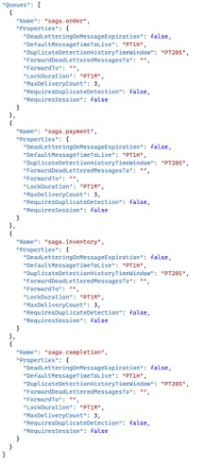
Documentation
saga.order
saga.payment
saga.inventory
saga.completion
Create the Namespace
Create the Queues

Slide 30
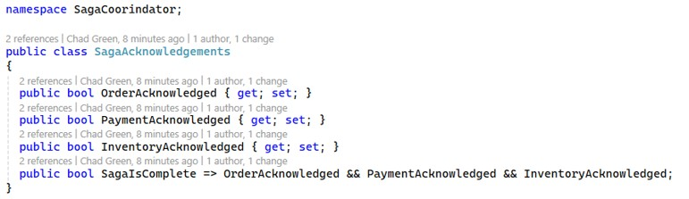
Documentation
Create the Namespace
Create the Queues
Create the Queues

Slide 31
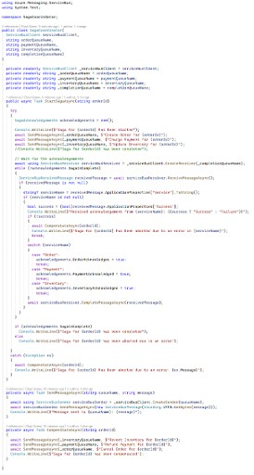
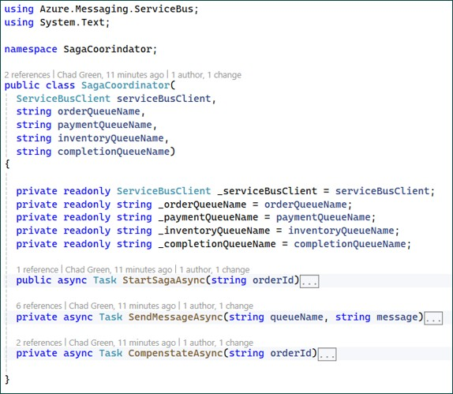
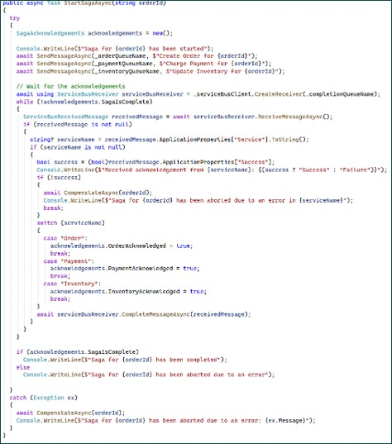
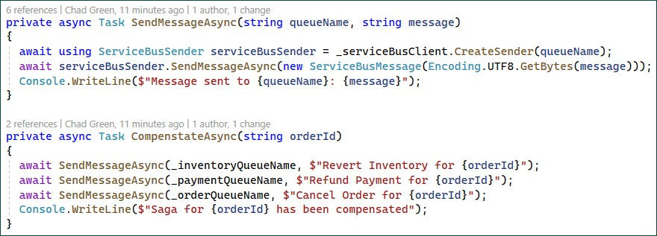
Documentation
Create the Namespace
Create the Queues
Create the Queues

Slide 32
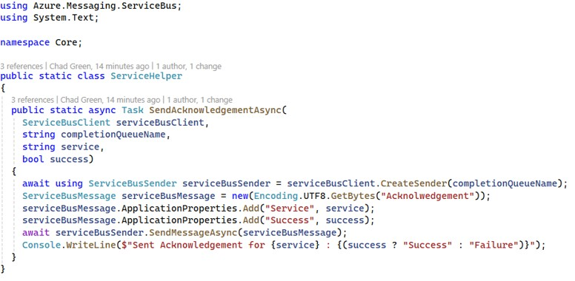
Documentation
Create the Namespace
Create the Queues
Create the Queues
Create the Services
Service Helper

Slide 33
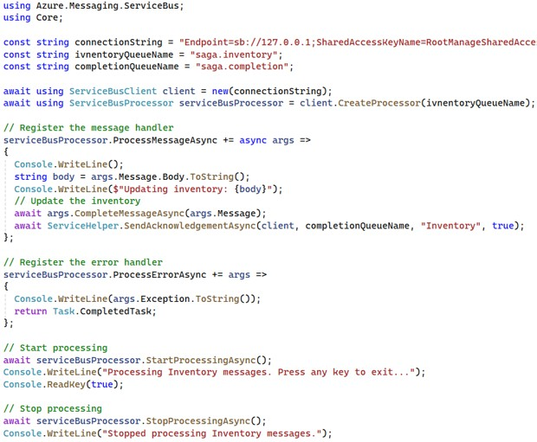
Documentation
Create the Namespace
Create the Queues
Create the Queues
Create the Services
Inventory

Slide 34
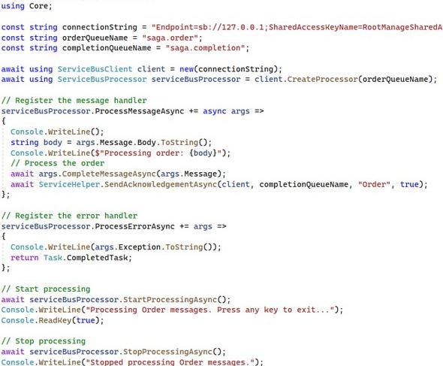
Documentation
Create the Namespace
Create the Queues
Create the Queues
Create the Services
Order

Slide 35
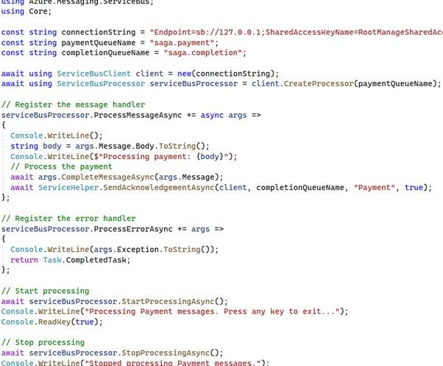
Documentation
Create the Namespace
Create the Queues
Create the Queues
Create the Services
Payment

Slide 36
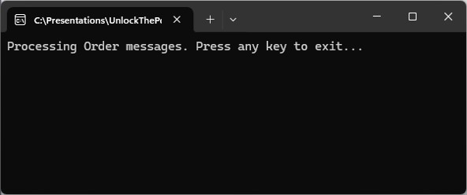
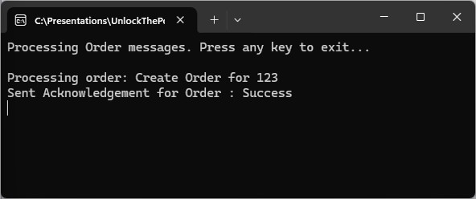


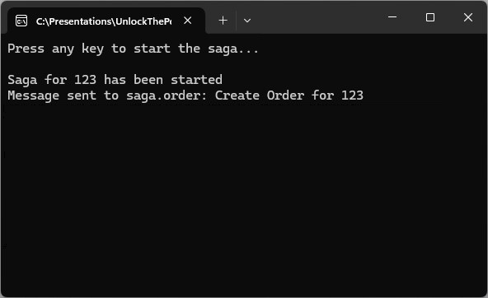
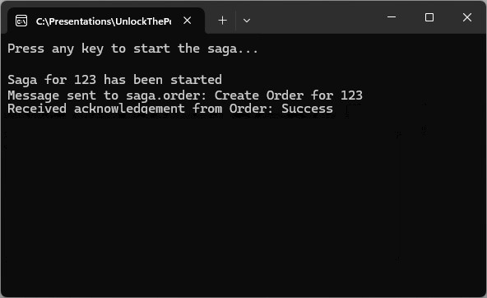
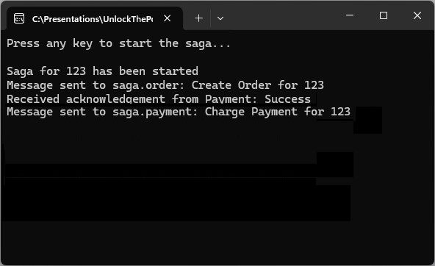
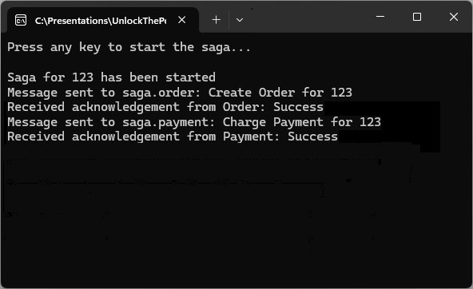
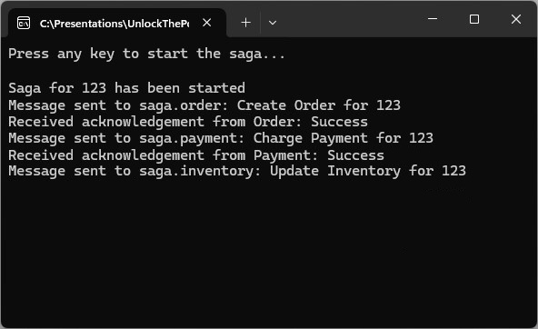
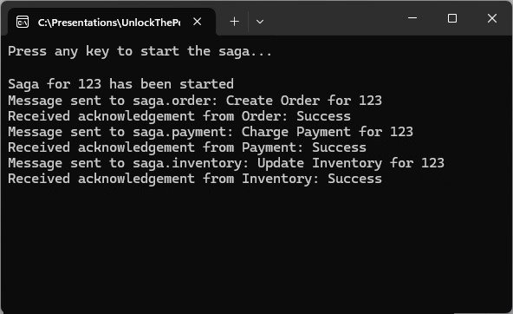
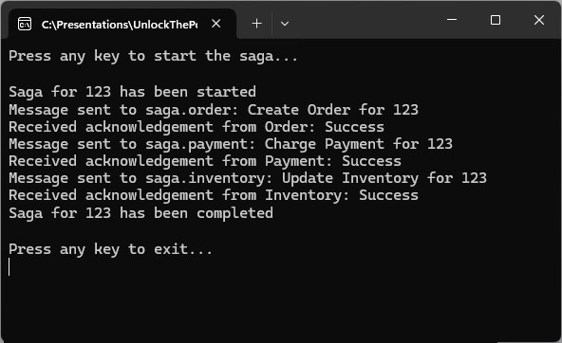
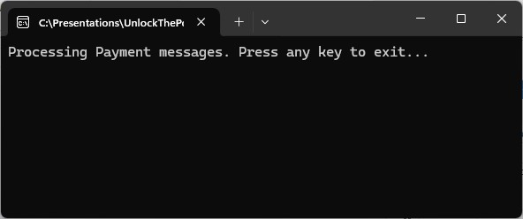
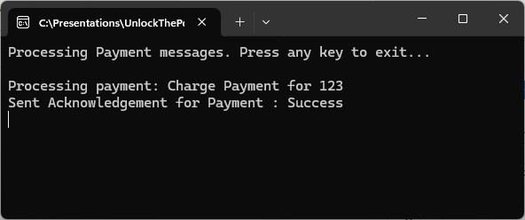
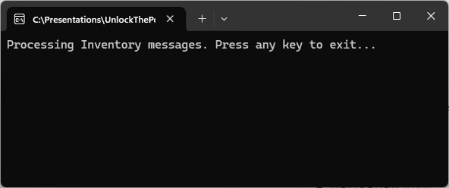
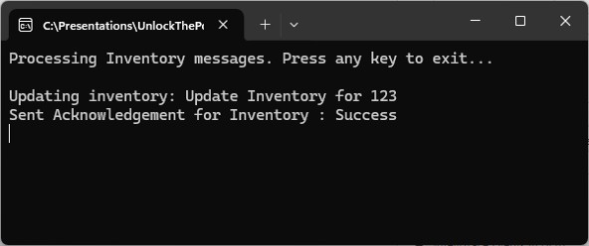
Documentation
Create the Namespace
Create the Queues
Create the Queues
Create the Services
Run the Demo

Slide 37
Key Points to Remember
Define Compensating Actions
Coordinate Steps
Track State
Handle Failures Gracefully
Notes:
Define Compensating Actions: Clearly define compensating actions for each transaction step to handle failures and maintain consistency.
Coordinate Steps: Use a Saga coordinator to manage the execution and coordination of transaction steps.
Track State: Implement state management to track the process and state of the Saga, ensuring proper execution and compensation.
Handle Failures Gracefully: Ensure the system can gracefully handle failures by executing compensating actions and maintaining data consistency.

Slide 38
Resilience & Reliability
Pattern 3: Sequence Convoy

Slide 39

Looks like we have a convoy!

Slide 40
What is the Sequence Convoy Pattern
Ensures that related messages are processed in order
Enforce message ordering
Notes:
Definition
The Sequential Convoy pattern ensures that related messages are processed in a specific order. This pattern is particularly useful in scenarios where the order of message processing is critical to maintaining data integrity and consistency.
Purpose
The purpose of the Sequential Convoy pattern is to enforce message ordering and guarantee that dependent messages are processed sequentially, preserving the intended sequence of operations.

Slide 41
Key Components & Flow
Message Queue
Order Key
Sequential Processor
Notes:
Message Queue: A queue that holds messages and ensures they are processed in the order they were received.
Order Key: A key or identifier used to group related messages and enforce their processing order.
Sequential Processor: A component responsible for processing messages in the correct order based on the order key.

Slide 42
Key Components & Flow
Message Queue
A
A
Order Key
A
A
A
B
B
A
B
Sequential Processor
Notes:
Message Queue: A queue that holds messages and ensures they are processed in the order they were received.
Order Key: A key or identifier used to group related messages and enforce their processing order.
Sequential Processor: A component responsible for processing messages in the correct order based on the order key.

Slide 43
Benefits
Data Integrity
Consistency
Reliability
Notes:
Data Integrity: Preserves the order of message processing, ensuring that operations are performed in the correct sequence.
Consistency: Maintains consistency in the system by guaranteeing the proper order of dependent operations.
Reliability: Reduces the risk of errors and inconsistencies by enforcing message ordering.

Slide 44
Drawbacks
Reduced Throughput
Complexity
Potential Latency
Notes:
Reduce Throughput: Processing messages sequentially can reduce throughput compared to parallel processing.
Complexity: Implementing and managing message ordering can add complexity to the system design.
Potential Latency: Enforcing sequential processing may introduce latency, especially in high-volume scenarios.

Slide 45
Use Cases
Order Processing
Event Sourcing
Workflow Management
Notes:
Order Processing
Ensuring that actions related to an order (e.g., order creation, payment, shipping) are processed in the correct sequence.
Event Sourcing
Maintaining the order of events in an event-soruced system to ensure accurate reconstruction of state.
Workflow Management
Executing steps in a workflow in the correct order to maintain consistency and data integrity.

Slide 46
Documentation
Create the Namespace

Slide 47
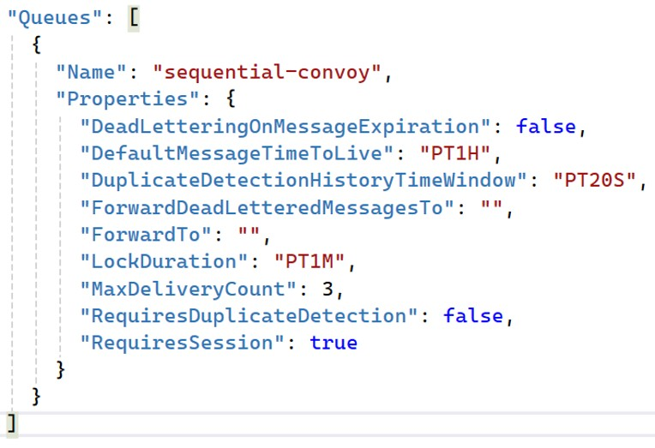
Documentation
Create the Namespace
Create the Queue

Slide 48
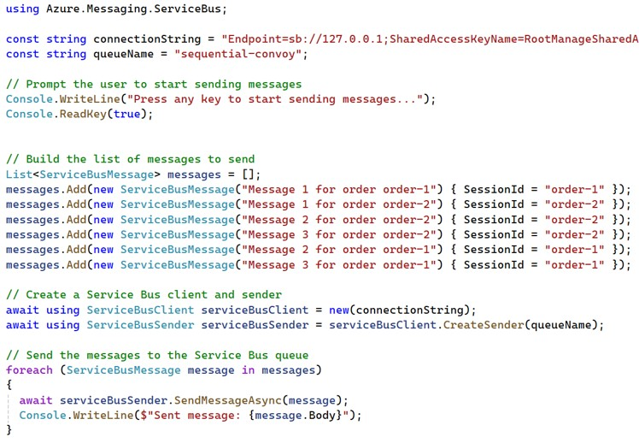
Documentation
Create the Namespace
Create the Queue
Create the Producer

Slide 49
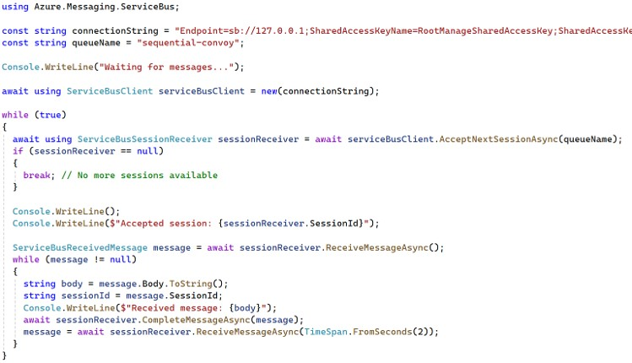
Documentation
Create the Namespace
Create the Queue
Create the Producer
Create the Consumer

Slide 50

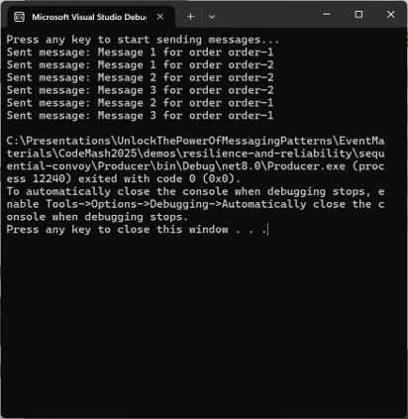

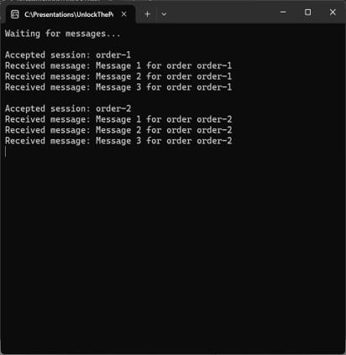
Documentation
Producer
Consumer
Create the Namespace
Create the Queue
Create the Producer
Create the Consumer
Run the Demo

Slide 51
Key Points to Remember
Use Order Keys
Ensure Queue Ordering
Monitor and Adjust
Handle Failures Gracefully
Notes:
Use Order Keys: Assign order keys to related messages to group and enforce their processing order.
Ensure Queue Ordering: Use message queues that guarantee message ordering to maintain the correct sequence of operations.
Monitor and Adjust: Continuously monitor the system to ensure that messages are being processed in the correct order and make adjustments as needed to optimize performance.
Handle Failures Gracefully: Implement mechanisms to handle message processing failures and ensure that the correct order is maintained during retries.

Slide 52
Resilience & Reliability
Wrap-Up
Notes:
As we conclude the Resilience and Reliability module, let’s summarize the key patterns and insights we have covered and preview what’s next.

Slide 53
Key Takeaways
Circuit Breaker
Saga
Sequential Convoy
Notes:
Key Takeaways:
Circuit Breaker: Introducing fault tolerance and resilience in your messaging solutions.
Saga: Managing long-running transactions with distributed systems
Sequential Convoy: Handling related messages in a specific order.
These patterns provide you with essential tools to ensure your messaging systems are resilient and reliable, capable of handling failures gracefully and maintaining high availability.

Slide 54
Preview of What’s Next in the Workshop
Messaging Essentials
Core Messaging Patterns
Routing & Processing
Advanced Processing Techniques
Resilience & Reliability
Streaming & Integrations
Data Considerations
Hands-On Exercises

Slide 55
Preview of What’s Next in the Workshop
Streaming & Integrations
Event Streaming
Notes:
In the next module, we will explore patterns that leverage continuous data streams and facilitate effective system integration. Here is a glimpse of what is to come:
Event Streaming: Continuously process data streams for real-time applications.
These patterns will round out your messaging toolkit, equipping you with the knowledge to design comprehensive and efficient messaging solutions. Stay tuned as we go into the next module of our workshop and complete the world of messaging patterns!

